Slide 1
Introduction to HTML*
Bernardo N. Yahya
*Adopted from various resources
권기현, Java, JSP를 배워 ORACLE JDBC로 완성하는 웹 프로그래밍.

Slide 2
Agenda
HTML Introduction
HTML Tag
HTML Tag List
HTML Document Link
HTML Table
HTML Frame

Slide 3
Introduction
HTML? Hypertext Markup Language
- “Normal text” surrounded by bracketed tags that tell browsers how to display web pages
Pages end with “.htm” or “.html”
HTML Editor – A word processor that has been specialized to make the writing of HTML documents more effortless.

Slide 4
Introduction
Codes enclosed in brackets
Usually paired
<TITLE>My Web Page</TITLE>
Not case sensitive
<TITLE> = <title> = <Title>

Slide 5
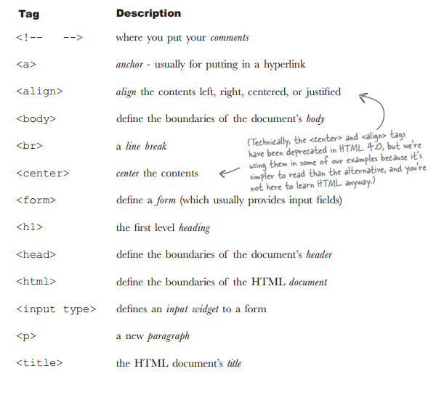
Introduction

Slide 6
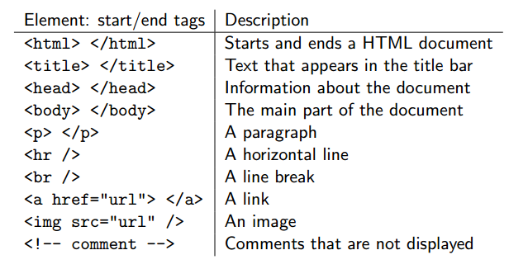
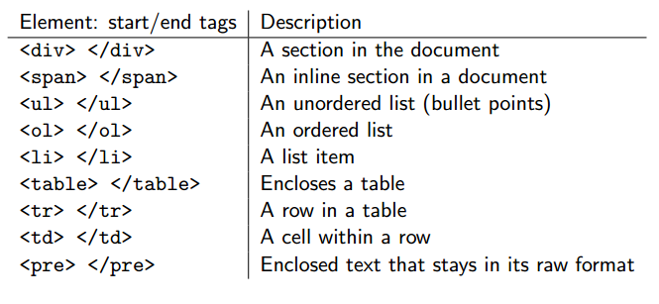
Introduction

Slide 7
HTML Tag
HTML Basic Structure (Example 1)
<HTML> To define the html
<HEAD>
<TITLE>Web Pages</TITLE> The title of the document
</HEAD>
<BODY>
Contents The view on the page
</BODY>
</HTML>

Slide 8
HTML Tag
Text property (Example 2)
Text and Background color
<HTML>
<HEAD>
<TITLE>Text property modification</TITLE>
</HEAD>
<BODY BGCOLOR=“#FFFFFF” TEXT=“#000000”>
How to change the text color?
</BODY>
</HTML>
BGCOLOR=“#FFCC00
TEXT=“#CC3300”
BGCOLOR=“#CC3300”
TEXT=“#FFFFFF”

Slide 9
HTML Tag
Colors are set using “RGB” color codes, which are, represented as hexadecimal values. Each 2-digit section of the code represents the amount, in sequence, of red, green or blue that forms the color. For example, a RGB value with 00 as the first two digits has no red in the color.

Slide 10
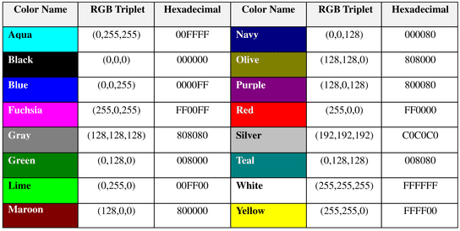
HTML Tag

Slide 11
HTML Tag
Heading 1
Document for Paragraph 1,
Line 2
___________________________
Line 3
Heading and Paragraph - Example 3
<HTML>
<HEAD>
<TITLE> Example Page</TITLE>
</HEAD>
<BODY BGCOLOR=“#FFFFFF” TEXT=“#000000”>
<H1><font face=“face” color=“#990066”></font> Heading 1 </H1>
<P> <font face=“face” color=“#990066” size=“5”></font> Document for Paragraph 1, <BR>
Line 2 <BR>
<HR>Line 3 <BR>
</P>
</BODY>
</HTML>
Heading Level 1
Break Line
Separate content in a page (i.e. horizontal rule)
Paragraph

Slide 12
HTML Tag
Inside the BODY element, heading elements <H1> through <H6> are generally used for major divisions of the document.
Headings are permitted to appear in any order
H1: should be used as the highest level of heading,
H2 as the next highest,
H3 as the next highest, and so forth.
You should not skip heading levels: e.g., an H3 should not appear after an H1, unless there is an H2 between them.

Slide 13
HTML Tag
Example 4
Heading 1
Heading 2
Heading 3
Heading 4
Heading 5
Heading 6
<HTML>
<HEAD>
<TITLE> Example Page</TITLE>
</HEAD>
<BODY>
<H1> Heading 1 </H1>
<H2> Heading 2 </H2>
<H3> Heading 3 </H3>
<H4> Heading 4 </H4>
<H5> Heading 5 </H5>
<H6> Heading 6 </H6>
</BODY>
</HTML>

Slide 14
HTML Tag
Example 5
<HTML><HEAD>
<TITLE> Example Page</TITLE>
</HEAD>
<BODY></H1> Heading 1 </H1>
<P> Paragraph 1, ….</P>
<H2> Heading 2 </H2>
<P> Paragraph 2, ….</P>
<H3> Heading 3 </H3>
<P> Paragraph 3, ….</P>
<H4> Heading 4 </H4>
<P> Paragraph 4, ….</P>
<H5> Heading 5 </H5>
<P> Paragraph 5, ….</P>
<H6> Heading 6</H6>
<P> Paragraph 6, ….</P>
</BODY></HTML>
Heading 1
Paragraph 1,….
Heading 2
Paragraph 2,….
Heading 3
Paragraph 3,….
Heading 4
Paragraph 4,….
Heading 5
Paragraph 5,….
Heading 6
Paragraph 6,….

Slide 15
HTML Tag
HTML supplies several list elements. Most list elements are composed of one or more <LI> (List Item) elements.
Tag | Descriptions
<OL> </OL> | Ordered List. Items in this list are numbered automatically by the browser. You have the choice of setting the TYPE Attribute to one of five numbering styles.
<UL> </UL> | Unordered List. Items in this list start with a list mark such as a bullet. Browsers will usually change the list mark in nested lists. You have the choice of three bullet types: disc(default), circle, square.
<LI> </LI> | List Items

Slide 16
HTML Tag List
<UL>
<LI> List item …</LI>
<LI> List item …</LI>
</UL>
List item …
List item …
<UL TYPE=“square”>
<LI> List item …</LI>
<LI> List item …</LI>
<LI> List item …</LI>
</UL>
List item …
List item …
List item …
<OL>
<LI> List item …</LI>
<LI> List item …</LI>
<LI> List item …</LI>
</OL>
List item …
List item …
List item …

Slide 17
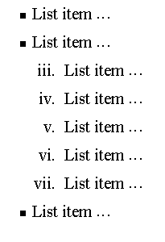
HTML Tag List
You can nest lists by inserting a UL, OL, etc., inside a list item (LI).
Example 6
<UL TYPE = “square”>
<LI> List item …</LI>
<LI> List item …
<OL TYPE=“i” START=“3”>
<LI> List item …</LI>
<LI> List item …</LI>
<LI> List item …</LI>
<LI> List item …</LI>
<LI> List item …</LI>
</OL>
</LI>
<LI> List item …</LI>
</UL>

Slide 18
HTML (Document) Links
How to make links
1) The tags used to produce links are the <A>
and </A>. The <A> tells where the link should start and
the </A> indicates where the link ends. Everything between these two will work as a link.
2) The example below shows how to make the word
Here work as a link to yahoo.
Click <A HREF="http://www.yahoo.com">here</A> to
go to yahoo.

Slide 19
HTML (Document) Links
More on Links
<body LINK="#C0C0C0" VLINK="#808080" ALINK="#FF0000">
LINK - standard link - to a page the visitor hasn't been to yet. (standard color is blue - #0000FF).
VLINK - visited link - to a page the visitor has been to before. (standard color is purple - #800080).
ALINK - active link - the color of the link when the mouse is on it. (standard color is red - #FF0000).
If the programmer want to change the color
Click <a href="http://www.yahoo.com"><font color="FF00CC">here</font></a> to go to yahoo.

Slide 20
HTML (Document) Links
Email (Electronic Mail)
E.g. mailto:kmf@yahoo.com
The type of service is identified as the mail client program. This type of link will launch the users mail client.
The recipient of the message is kmf@yahoo.com
<A HREF=“mailto:kmf@yahoo.com”>Send me
More Information </A>

Slide 21
HTML (Document) Links
Hyperlink
To relate document and document or document and images, data, etc.
To specify a specific target
<a href=“hyperlink path” target=“target”>Contents</a> : Set the link content
_blank
Opens the linked document in a new window or tab
_parent
Opens the linked document in the parent frame
_self
Opens the linked document in the same frame as
it was clicked (this is default)
_top
Opens the linked document in the full body of the window

Slide 22
HTML (Document) Links
Example 7
<h4 align="center"><a href=“lecture.pdf" target="_blank">Lecture Download</a></h4>

Slide 23
HTML Table(표만들기)
The table row elements usually contain table header elements or table data elements.
Tag | Descriptions
<TABLE></TABLE> | Table elements
<TR></TR> | Table Row
<TH></TH> | Table Header
<TD></TD> | Table Data
<CAPTION></CAPTION> | Caption

Slide 24
HTML Table
Example 8
<table border=“1”>
<tr>
<th> Column 1 header </th>
<th> Column 2 header </th>
</tr>
<tr>
<td> Row1, Col1 </td>
<td> Row1, Col2 </td>
</tr>
<tr>
<td> Row2, Col1 </td>
<td> Row2, Col2 </td>
</tr>
</table>
Column 1 Header | Column 2 Header
Row1, Col1 | Row1, Col2
Row2, Col1 | Row2, Col2

Slide 25
HTML Table(모르겠다 한번씩해보기)
Table Attributes
BGColor | Some browsers support background colors in a table.
Width | you can specify the table width as an absolute number of pixels or a percentage of the document width. You can set the width for the table cells as well.
Border | You can choose a numerical value for the border width, which specifies the border in pixels
CellSpacing | Cell Spacing represents the space between cells and is specified in pixels
CellPadding | Cell Padding is the space between the cell border and the cell contents and is specified in pixels.
Align | tables can have left, right, or center alignment
Background | Background Image, will be titled in IE3.0 and above
Caption | A table caption allows you to specify a line of text that will appear centered above or bellow the table. The Caption element has one attribute ALIGN that can be either TOP (Above the table) or BOTTOM (below the table).

Slide 26
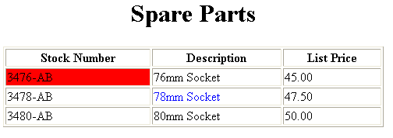
HTML Table
Basic Table Code (Example 9)
<TABLE BORDER=1 width=50%>
<CAPTION> <h1>Spare Parts <h1> </Caption>
<TR><TH>Stock Number</TH><TH>Description</TH><TH>List Price</TH></TR>
<TR><TD bgcolor=red>3476-AB</TD><TD>76mm Socket</TD><TD>45.00</TD></TR>
<TR><TD >3478-AB</TD><TD><font color=blue>78mm Socket</font> </TD><TD>47.50</TD></TR>
<TR><TD>3480-AB</TD><TD>80mm Socket</TD><TD>50.00</TD></TR>
</TABLE>

Slide 27
HTML Table
Table Data and Table Header 표 속성 정의
Colspan | Specifies how many cell columns of the table this cell should span
Rowspan | Specifies how many cell rows of the table this cell should span
Align | cell data can have left, right, or center alignment
Valign | cell data can have top, middle, or bottom alignment
Width | you can specify the width as an absolute number of pixels or a percentage of the document width
Height | You can specify the height as an absolute number of pixels or a percentage of the document height

Slide 28
HTML Table
Table Data and Table Header Attributes
Example 10
<Table border=1 cellpadding =2>
<tr> <th> Column 1 Header</th>
<th> Column 2 Header</th> </tr>
<tr> <td colspan=2> Row 1 Col 1</td> </tr>
<tr> <td rowspan=2>Row 2 Col 1</td>
<td> Row 2 Col2</td> </tr>
<tr> <td> Row 3 Col2</td> </tr>
</table>
Column 1 Header | Column 2 Header
Row 1 Col 1
Row 2 Col 1 | Row 2 Col 2
 | Row 3 Col 2

Slide 29
HTML Table(표 속성)
Width
Table width setting
<TABLE>,<TR>,
<TD>
height
Table height setting
bgcolor
Table background color setting
background
Table background image
align
Table alignment
border
Table border line
<TABLE>
cellspacing
Cell and cell spacing setting
cellpading
Cell and paragraph setting
bordercolorlight
Table border line light color
bordercolordark
Table border line dark color
valign
Cell vertical content setting
<TR><TD>
colspan
Span of the table’s column
rowspan
Span of the table’s row

Slide 30
HTML Table
What will be the output? (Example 11)
<TABLE BORDER width=“750”>
<TR> <TD colspan=“4” align=“center”>Page Banner</TD></TR>
<TR> <TD rowspan=“2” width=“25%”>Nav Links</TD>
<TD colspan=“2”>Feature Article</TD>
<TD rowspan=“2” width=“25%”>Linked Ads</TD>
</TR>
<TR><TD width=“25%”>News Column 1 </TD> <TD width=“25%”><News Column 2 </TD></TR>
</TABLE>

Slide 31
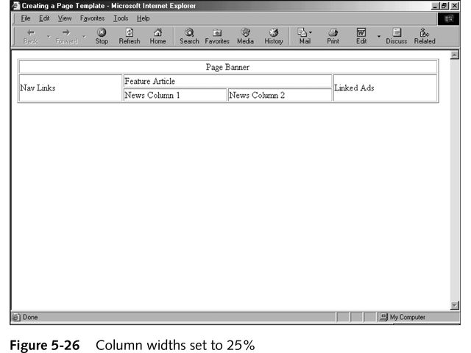
HTML Table
The Output

Slide 32
HTML Frame
Frame
Understanding Frame and Frameset
- It is able to manage the content of a page and to work with high efficiency
- The example shows three HTML files to represent a page
Frame Menu
(MENU.HTML)
Frame Main
(MAIN.HTML)
Frame set(INDEX.HTML)

Slide 33
HTML Frame
Frame document basic structure
<FRAMESET> //Frame Set definition
<FRAME SRC=“Homepage”> //Insert the assigned homepage document frame
</FRAME>
</FRAMESET>

Slide 34
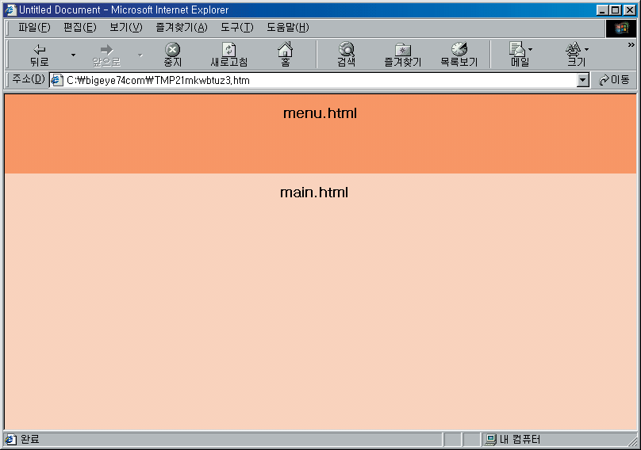
HTML Frame
Main menu in the bottom
<FRAMESET ROWS=“100,*”> Upper Frame with 100 pixels
<FRAME SRC=“menu.html”> Upper menu frame
<FRAME SRC=“main.html”> Lower menu frame
</FRAMESET>

Slide 35
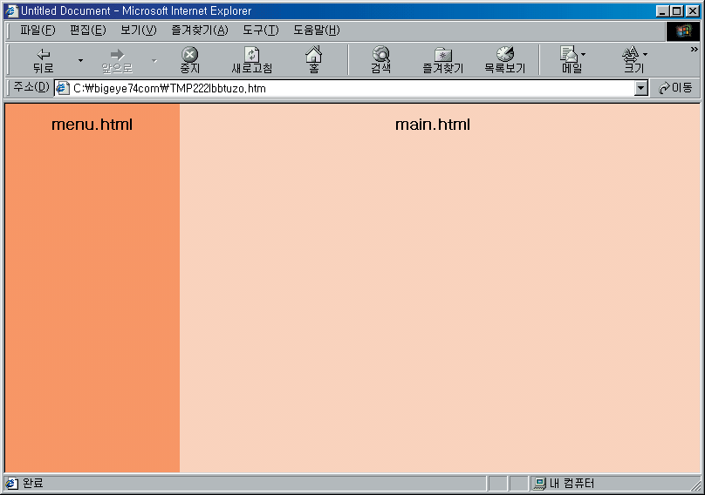
HTML Frame
Menu in the left
<FRAMESET COLS=“200,*”> // Left frame is set to 200 pixel
<FRAME SRC=“menu.html”> // Left frame
<FRAME SRC=“main.html”> // Right frame
</FRAMESET>

Slide 36
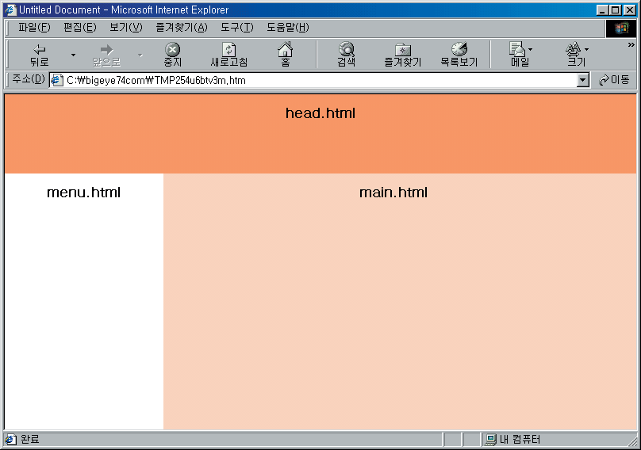
HTML Frame
Three level of frames
<FRAMESET ROWS=“100,*”> // Top header frame with height 100 pixel
<FRAME SRC=“head.html”> // Top header frame
<FRAMESET COLS=“200,*”> // Left frame width 200 pixel
<FRAME SRC=“menu.html”> // Left frame
<FRAME SRC=“main.html”> // Right main frame
</FRAMESET>
</FRAMESET>

Slide 37
End of HTML Introduction
Next, we will learn about JSP.

